Slide 1

CHINOOK MUSIC STORE
FIRDOS BANU S
9/3/2025

Slide 2
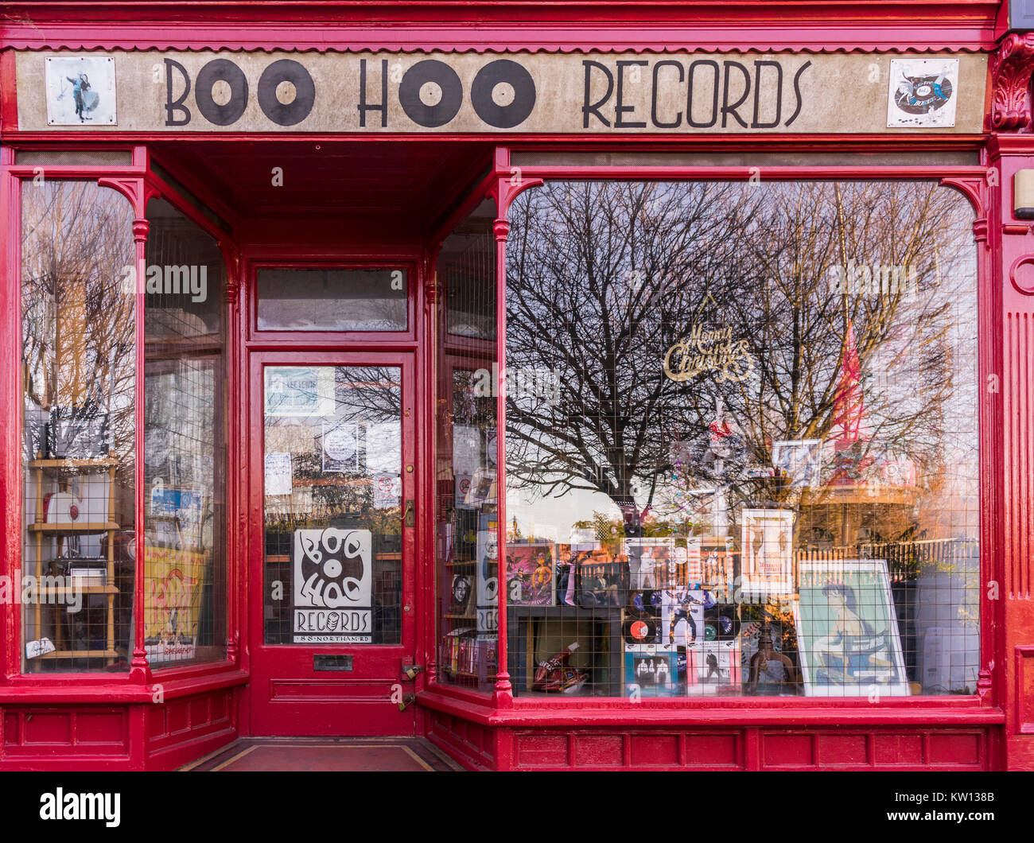
DID YOU KNOW?????
The first-ever digital music store, iTunes, launched in 2003 and sold over 1 million songs in its first week!

Slide 3
PROBLEM STATEMENT
You are hired as a data analyst at Chinook, and your objective is to analyze music record sales data to gain insights and make recommendations for the company's strategy in the physical music market.
Objectives:
Analyze Music Sales Data – Identify sales trends across different genres, artists, and albums.
Understand Customer Preferences – Study purchase frequency, spending habits.
Identify High-Value Customers – Find top spenders and their buying patterns.
Track Seasonal Sales Trends – Analyze monthly and yearly fluctuations in music sales.
Optimize Inventory & Pricing – Recommend stock adjustments and pricing strategies for maximum revenue.

Slide 4

ABOUT CHINOOK MUSIC STORE
Chinook Music Store is a digital music retailer selling individual tracks and albums.
It operates in a similar model to iTunes, offering a variety of music genres.
The store sells music in digital format, with customer purchases recorded in a database.
The database includes customers, invoices, tracks, artists, and employees.
Transactions are processed via invoices, linking purchases to customers and payment details.
The store aims to analyze customer behavior, sales trends, and revenue insights for business growth.

Slide 5
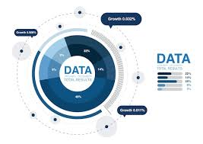
DATA OVERVIEW
Total Customers: 🎧 59 customers from different countries.
Total Invoices: 🧾 412 invoices recording all music purchases.
Total Invoice Lines: 🎼 2,240 individual track purchases across all invoices.
Total Tracks: 🎵 3,475 unique songs available for purchase.
Total Albums: 💿 347 albums from various artists.
Total Artists: 🎤 275 artists contributing to the music collection.
Total Genres: 🎶 25 different music genres categorized.
Total Employees: 👥 8 employees managing sales and operations.
📌Geographical Coverage: Customers are from various countries, including the USA, Canada, Germany, France, and more.

Slide 6
DATA CLEANING STEPS UNDERTAKEN
Removed Duplicates – Checked for any duplicate records in the tables.
Handled Missing Values – Verified missing or null values in key columns like customer details, invoice amounts, and track prices
Standardized Data Formats – Ensured date formats (YYYY-MM-DD), currency consistency, and proper text capitalization for names and locations.
Checked for Inconsistencies – Verified relationships between tables (e.g., each invoice links to a valid customer, and all tracks belong to an album).
Validated Data Types – Ensured numerical fields (like prices and invoice totals) are correctly formatted as decimals, and text fields (like names) have consistent formatting.

Slide 7

WHY IS THE DATA CRUCIAL??
Tracks customer behavior – Helps understand purchases and preferences.
Reveals revenue insights – Identifies top customers and high-selling genres.
Analyzes market trends – Shows popular artists, albums, and genres.
Improves customer retention – Compares long-term vs. new buyers.
Evaluates sales performance – Tracks monthly and seasonal trends.

Slide 8
Description of analytical methods and tools used
SQL Queries –Used to extract, filter, and analyze customer purchases, sales trends, and revenue insights from the Chinook database.
Descriptive Statistics – Measured total sales, average order value, and purchase frequency.
Data Visualization (Excel) – Created charts for sales trends, top customers, and genre performance.
Customer Segmentation – Compared long-term vs. new customer behavior.
Trend Analysis – Identified seasonal sales patterns and high-demand genres.
Revenue Analysis – Found top revenue-generating customers and best-selling tracks.

Slide 9
GENRES BASED ON TOP SELLING TRACKS AND TOP ARTIST

Slide 10
OBSERVATION:
Rock is the most popular genre in the USA, based on both top-selling tracks and the best-selling artist.
Rock appears twice in the top 5 tracks, suggesting it is one of the popular genres in the USA.
Van Halen dominates the USA market, suggesting a strong fanbase and high album sales.
Rock-based genres (Rock, Metal, Alternative) make up 4 out of 5 top-selling tracks, proving that heavier music styles are widely listened to.
R&B/Soul is also present, showing that some listeners prefer different styles.

Slide 11
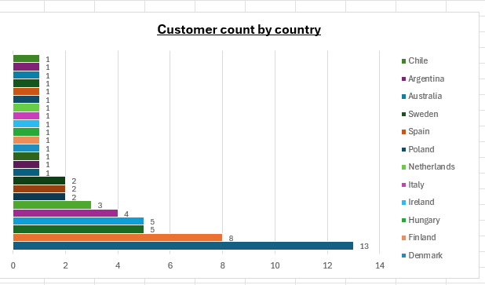
CUSTOMER COUNT BY COUNTRY

Slide 12
OBSERVATION:
USA and Canada dominate Chinook’s customer base, making up over 50% of total customers.
Brazil and France are important secondary markets, showing potential for expansion.
Europe has multiple small markets, but no single country is a dominant player.
Presence in India, Australia, and Latin America suggests Chinook could focus on global marketing

Slide 13
TOTAL REVENUE GENERATED BY EACH COUNTRY

Slide 14
OBSERVATION:
The USA is the largest market, contributing 22.1% of total revenue ($1040.49 out of $4709.43)
Canada and Brazil also perform strongly, with Brazil ranking third despite having fewer customers than Canada.
European countries like France and Germany are major revenue drivers, showing strong engagement in music purchases.

Slide 15
PERCENTAGE OF SALES CONTRIBUTED BY EACH GENRE

Slide 16
OBSERVATION:
Prioritize Rock – Continue marketing, promoting, and bundling Rock albums as it the top selling genre.
Leverage Niche Markets – Push Alternative, Punk, and Metal with targeted campaigns.
Boost Low-Selling Genres – Explore pricing strategies or promotional playlists for minor genres.

Slide 17
TOTAL SALES CONTRIBUTED BY EACH ARTIST

Slide 18
OBSERVATION:
Van Halen has the highest sales contribution, meaning their albums/tracks are the most purchased.
Both R.E.M. and The Rolling Stones contribute significantly to sales.
Investigate Nirvana & Foo Fighters Sales – Analyze customer engagement, pricing, and demand.

Slide 19
GENRE RANKING BASED ON SALES PERFORMANCE IN USA

Slide 20
OBSERVATION:
The Rock genre has significantly higher total sales compared to other genres, making it the most popular genre in the USA.
Target Rock and Metal Audiences – Since these genres are driving sales, the business should focus on promoting and expanding their Rock and Metal offerings.
More marketing efforts can be made for genres like Hip Hop/Rap and Latin to increase their visibility.
Since TV Shows and Electronica/Dance have lower sales, bundle deals or promotions could boost their performance.

Slide 21
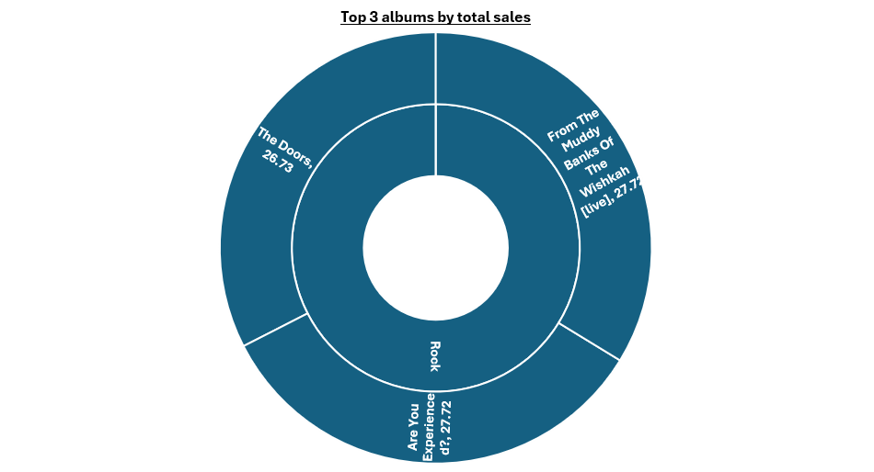
TOP 3 ALBUMS BY TOTALSALES

Slide 22
INSIGHTS:
Rock is the dominant genre in the USA
All top 3 albums belong to the Rock genre, indicating that Rock music has the highest sales in the US market.
This suggests a strong customer preference for Rock albums, making it a priority for marketing efforts.
Since Rock already has a high demand, strategic advertising and promotions can boost these sales further.

Slide 23
RECOMMENDATIONS:
Since Rock is the best-selling genre, marketing should heavily target Rock listeners.
Use social media ads, influencer collaborations, and genre-based promotions on platforms like Spotify and Apple Music.
Target existing Rock music fans and past buyers of similar albums.
Sponsored promotions on music streaming apps will increase visibility and sales.
Run Instagram & Facebook ads targeting Rock fans in the USA.

Slide 24
FREQUENTLY PURCHASED GENRES, ALBUMS, ARTISTS BY CUSTOMERS

Slide 25
INSIGHTS:
The most frequently purchased genres together include Rock and Metal (1622 purchases), Rock and Alternative & Punk (1056 purchases), and Rock and Latin (427 purchases).
Metal & Alternative & Punk (315 purchases) frequently appear together, indicating that these audiences have overlapping preferences.
Led Zeppelin & Green Day (24 purchases), Green Day & Foo Fighters (20 purchases), and Eric Clapton & Nirvana (19 purchases) suggest that classic rock, grunge, and punk fans have shared interests.
Metallica & Green Day (18 purchases) shows that even heavier rock fans sometimes cross over into punk music.

Slide 26
Product recommendations and cross-selling initiatives:
Customers who purchase Rock albums (e.g., Led Zeppelin, Foo Fighters) can be recommended Metal albums (e.g., Metallica, Iron Maiden) based on frequent co-purchases.
Fans of Green Day can be recommended Nirvana and Foo Fighters, as they have strong cross-buying behavior.
If a customer streams or buys a Metal album, suggest Alternative & Punk playlists since these genres frequently cross over.
Offer discounts on albums frequently purchased together

Slide 27
KEY INSIGHTS DERIVED FROM THE ANALYSIS
Top Customers Drive Revenue – A few high-value customers contribute significantly to sales.
Popular Genres & Artists Identified – Certain genres and artists generate the most sales.
Long-Term Customers Spend More – They make frequent purchases over time.
Basket Size is Small – Customers buy single tracks instead of full albums.
Average Order Value Varies – The highest average order value is $11.11, while the lowest is $7.13.

Slide 28
SPECIFIC RECOMMENDATIONS
Enhance Customer Retention – Offer loyalty programs, discounts, or exclusive deals to high-value customers (e.g., top spenders like Customer ID 5 with $144.54 in revenue).
Increase Purchase Frequency – Encourage repeat purchases with personalized recommendations, targeted promotions, and email marketing for customers with fewer than 15 purchases.
Boost Average Order Value – Introduce bundle discounts for full albums or multi-track purchases, as the current average order value ranges between $7.13 and $11.11.
Expand High-Demand Genres – Prioritize stocking and promoting top-selling genres and artists to drive more sales.
Improve Pricing Strategies – Experiment with dynamic pricing, limited-time discounts, or exclusive album bundles to encourage larger purchases.

Slide 29

CONCLUSION:
"Leveraging data insights, Chinook can boost sales, improve customer retention, and drive
long-term growth in the music industry."

Slide 30


